Slide 1
Assembly Language and System Programming – Lab8(Week10)
2022/11/14

Slide 2
Target
Target：Find the largest number in the array.
Task：Add a Procedure(FindLargest) to your program, pass two parameters after calling FindLargest.：
1. aPtr -> Points to the incoming Array
2. arraySize -> The size of the array
Find the largest number in the array and save the result to register eax.

Slide 3
Program Architecture
.stack 4096
_______ PROTO _____ , _______ ; Declare the prototype of FindLargest
.data Ex1Array sdword 105522063 , ___________ , ___________
;The array initialized with 105522063, Student ID-1, Student ID-2
Ex2Array sdword -105522063 , ___________ , ____________
; The array initialized with -105522063, Negative Student ID-1, Negative Student ID-2
.code
main proc
_____ FindLargest, _____ Ex1Array, _________ Ex1Array
_____ FindLargest, _____ Ex2Array, _________ Ex2Array
call WaitMsg
invoke ExitProcess,0
main endp
end main

Slide 4
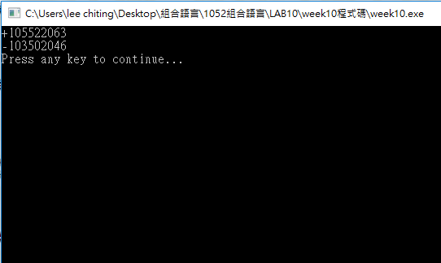
Result

Slide 5
Report
Deadline : 2022/11/15(Tue.)Before 12:00 P.M. (EEClass)
Each group only needs to submit one report
Pack the following files and compress into .zip file.
Code (lab8_groupX.asm)
Report (lab8_groupX.doc or lab8_ groupX.pdf)
Title
Group、StudentID、Name
Screenshots of Result and Code + Explanation
The report has to clearly explain how the program works.
Thoughts about the lab.
Please must be aware of the file name.

Slide 6
Contact Info：
Jeffrey’s Email: jeffrey890705@gmail.com
Jim’s Email: kg128888@gmail.com

Slide 7
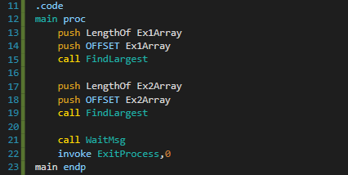
Param 2 for FindLargest PROC
Param 1 for FindLargest PROC
Call PROC
Param 2 for FindLargest PROC
Param 1 for FindLargest PROC
Call PROC

Slide 8
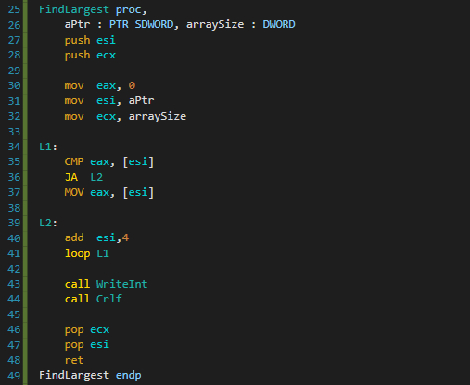
Save origin value of esi/ecx
Init value
eax for result
esi for array pointer
ecx for loop count
Check if next value in array is bigger than eax
if true
update eax value (do not jump to L2 and run Line 37)
else
jump to L2
Move ptr to next value (1 DWORD = 4 BYTE)
Loop until iterated all elements in input array
Print result
Load origin value of esi/ecx

